Slide 1
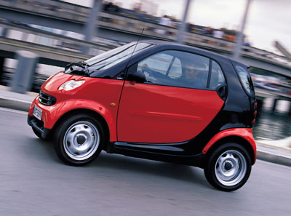
Notes:
Smart car

Slide 2

Notes:
Maserati

Slide 3
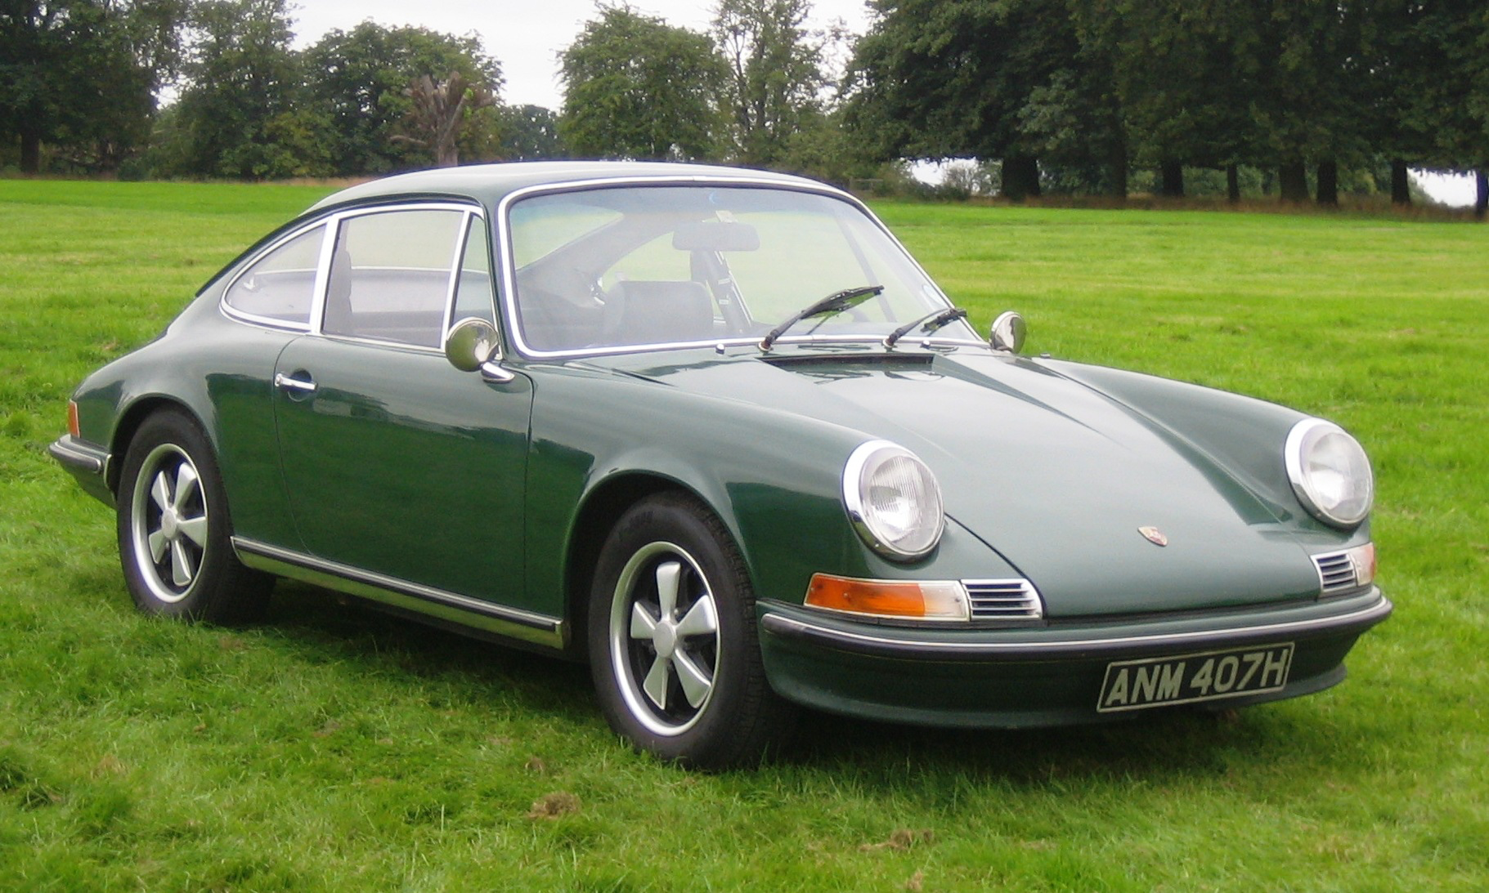
Notes:
Porsche 911

Slide 4
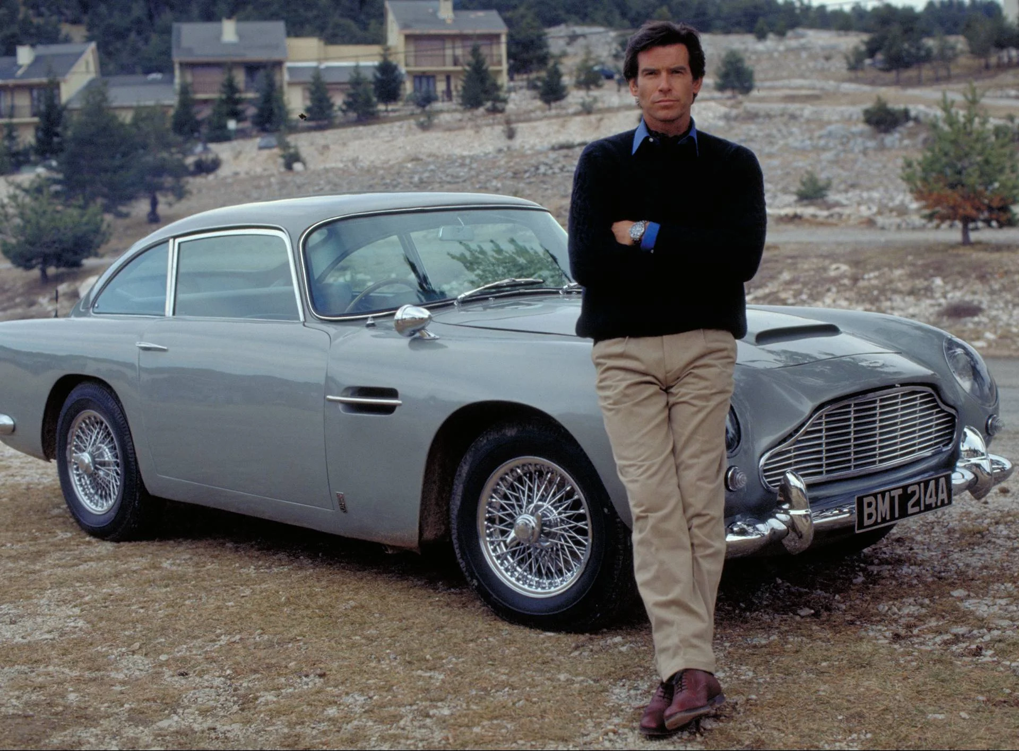
Notes:
Aston Martin DB5

Slide 5

Notes:
The Mystery Machine

Slide 6
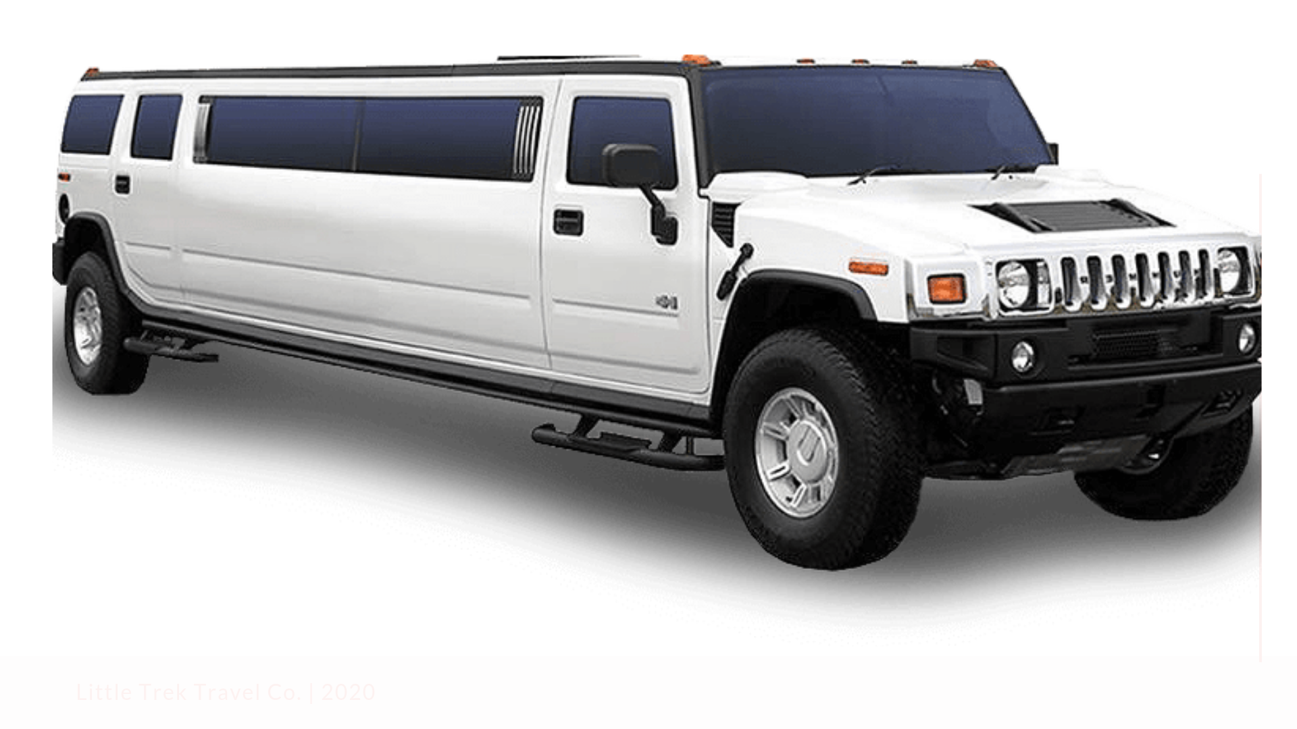
Notes:
Hummer limo

Slide 7

Notes:
Citroen

Slide 8
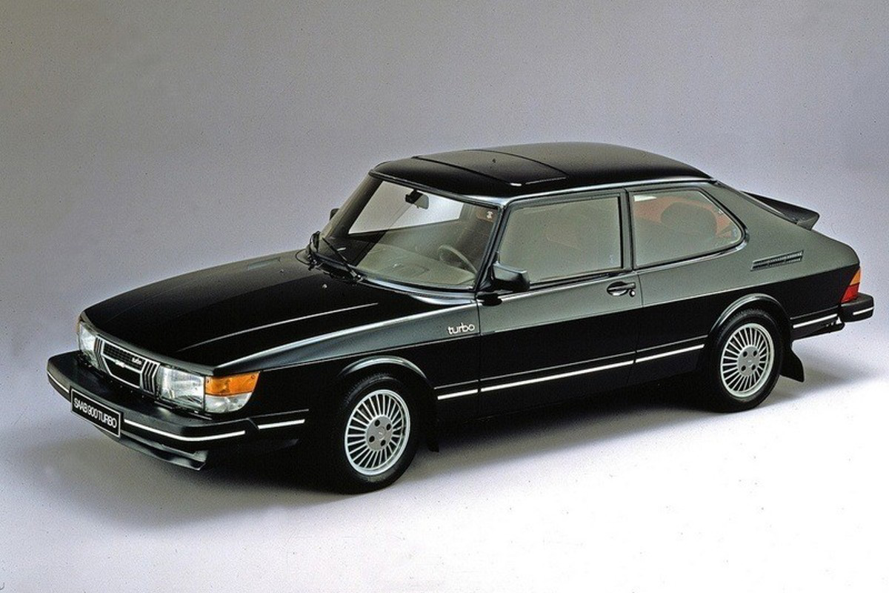
Notes:
Saab 900

Slide 9
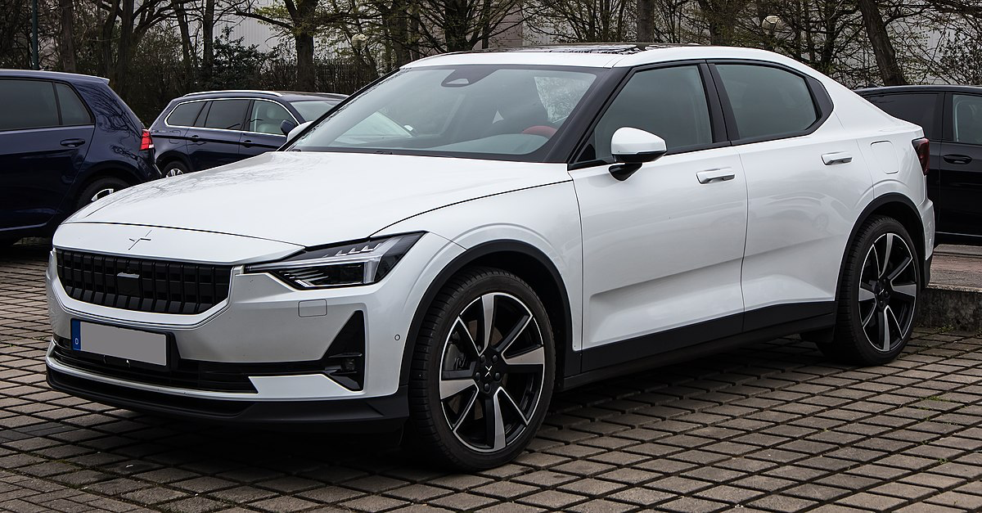
Notes:
Polestar 2

Slide 10

Notes:
Mitsubishi

Slide 11
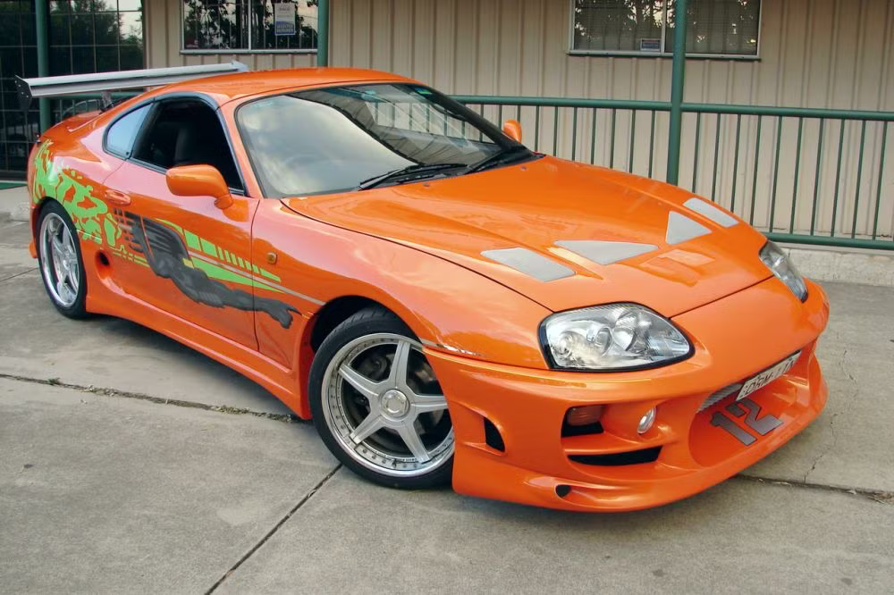
Notes:
1995 Toyota Supra

Slide 12
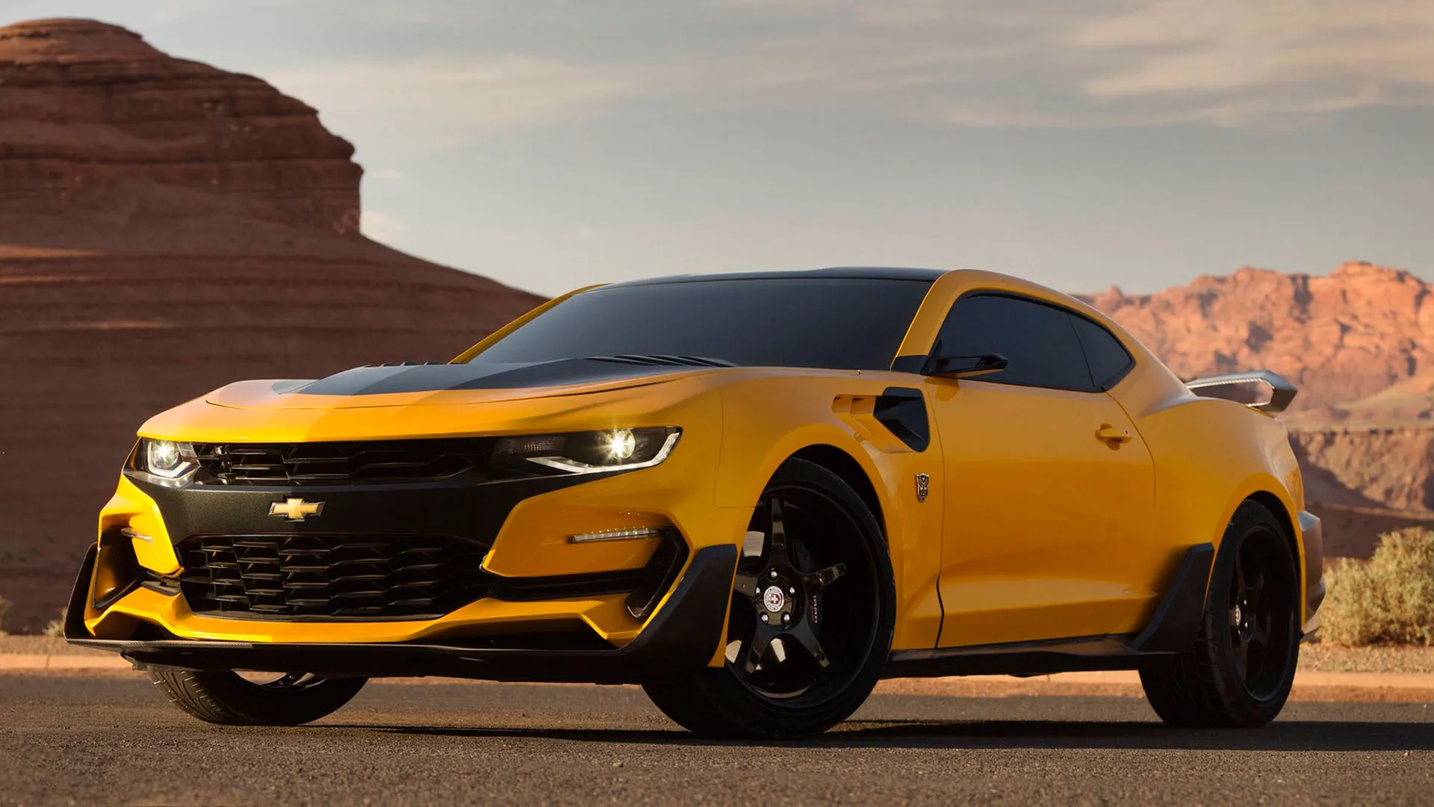
Notes:
Chevy Camaro (Bumblebee)

Slide 13
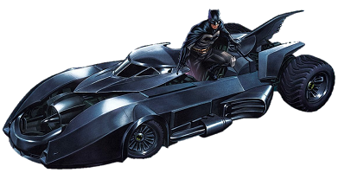
Notes:
Batmobile

Slide 14
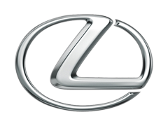
Notes:
Lexus

Slide 15
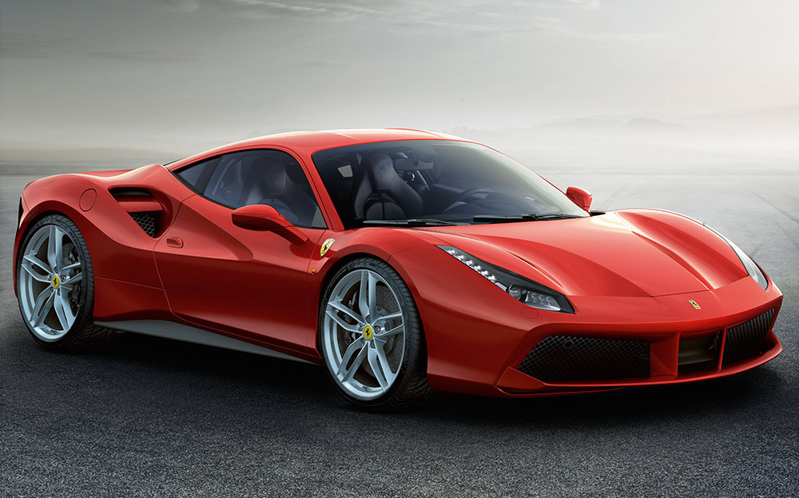
Notes:
Ferrari 488

Slide 16
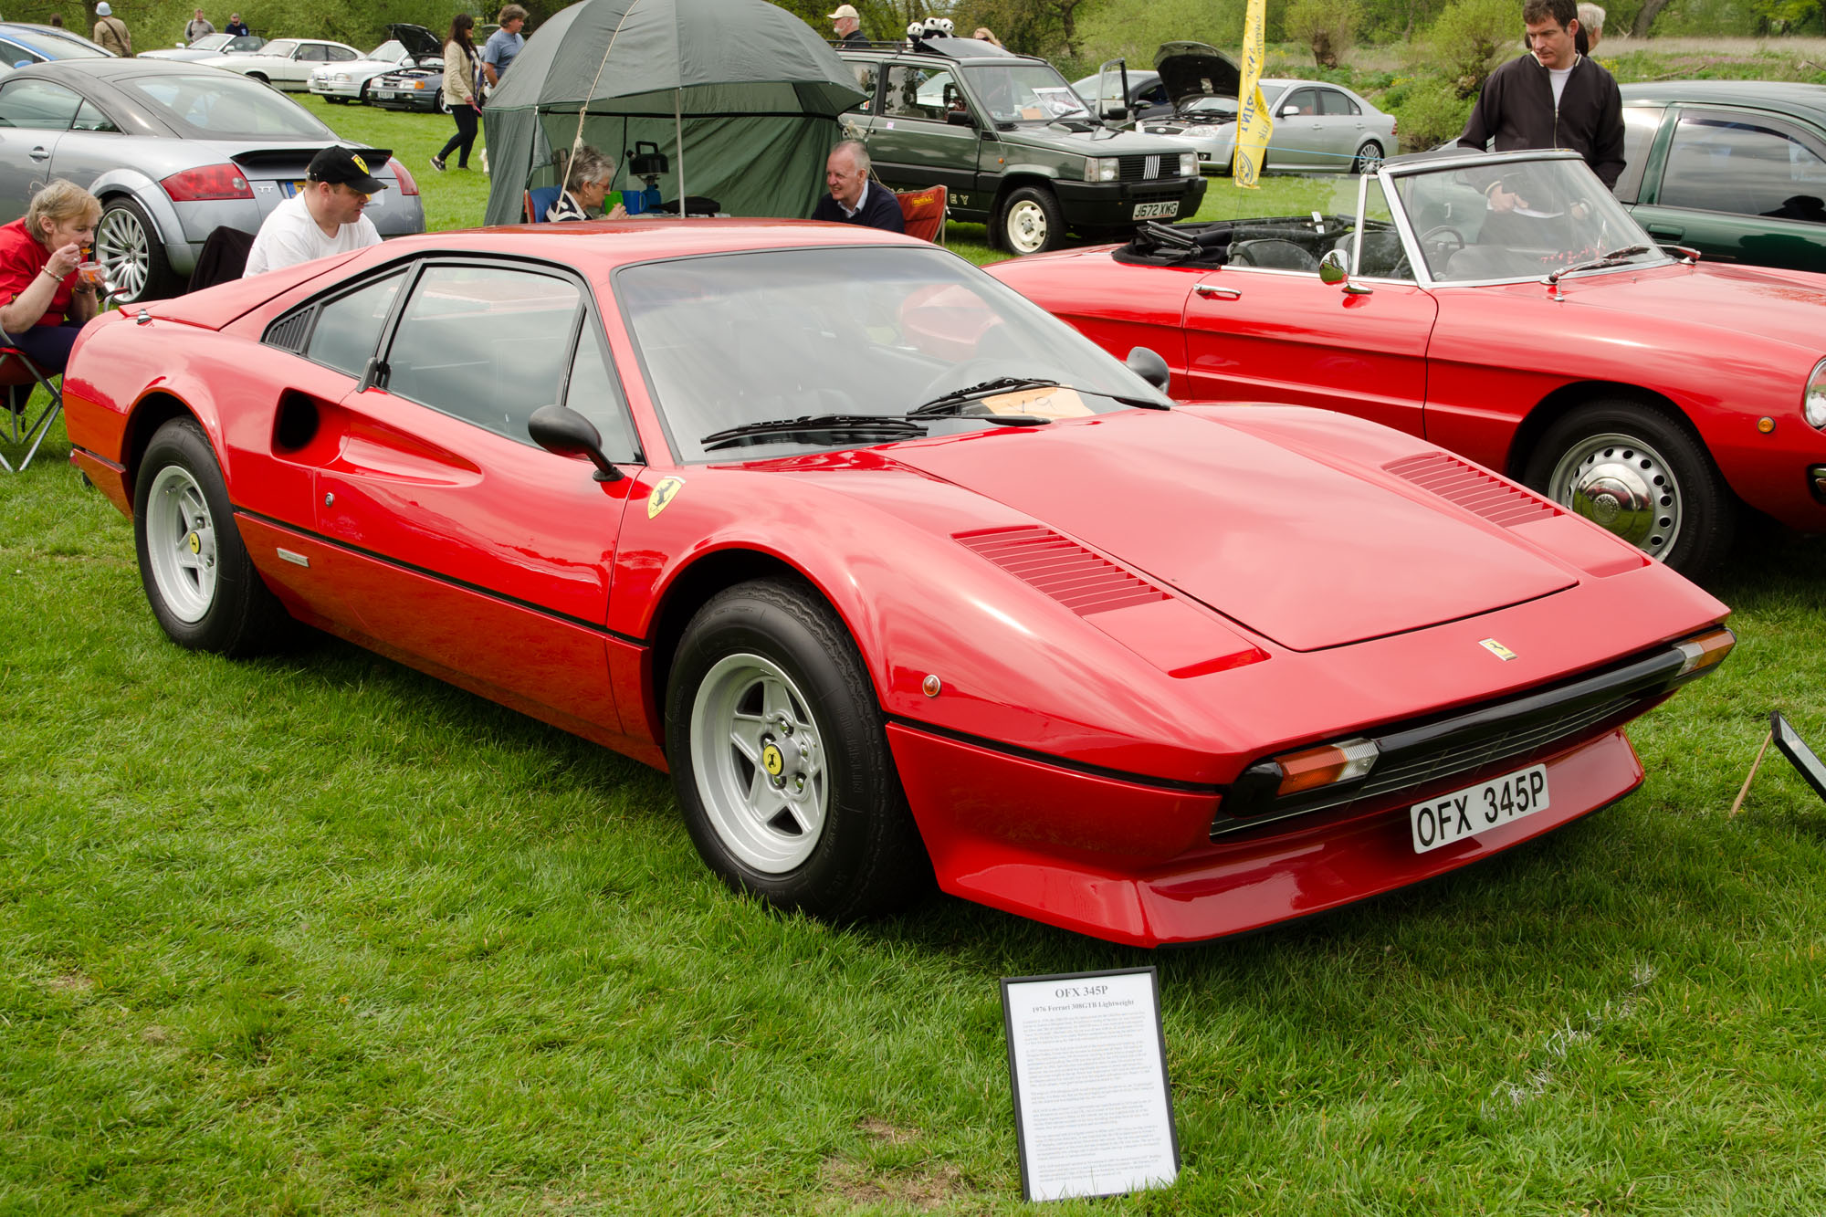
Notes:
Ferrari 308 GTS

Slide 17
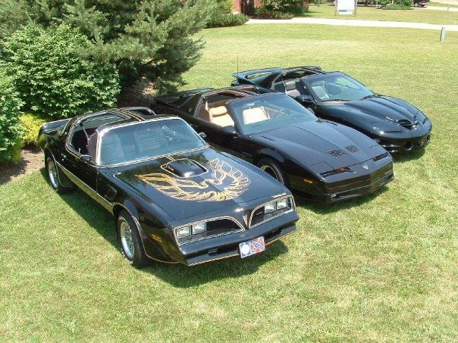
Notes:
Pontiac Firebird (Trans Am)

Slide 18
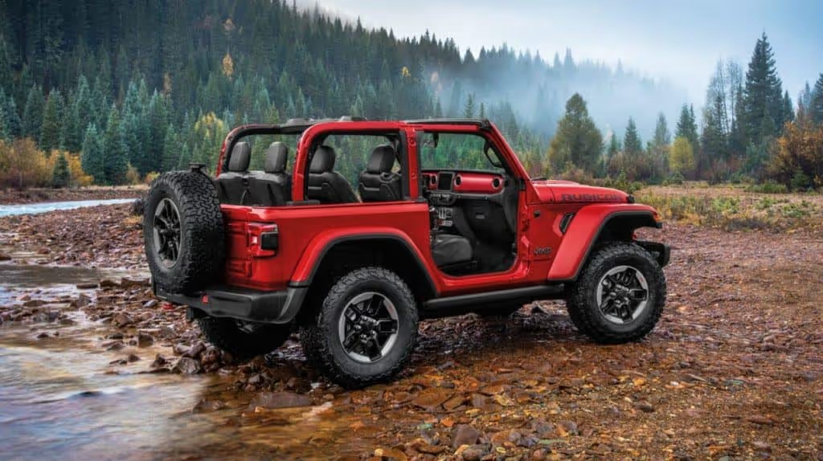
Notes:
Jeep Wrangler

Slide 19
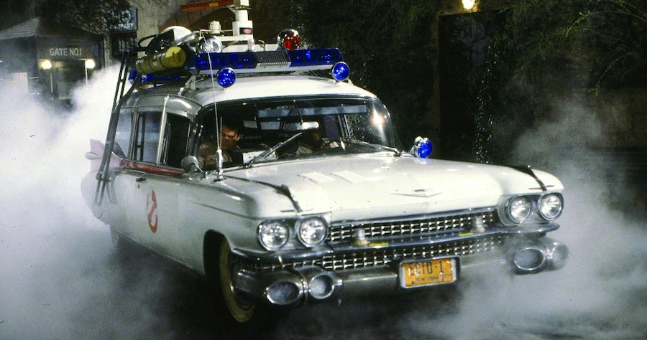
Notes:
Ectomobile/Ecto-1

Slide 20

Notes:
Mercedes-Benz

Slide 21

Notes:
Tow Mater

Slide 22
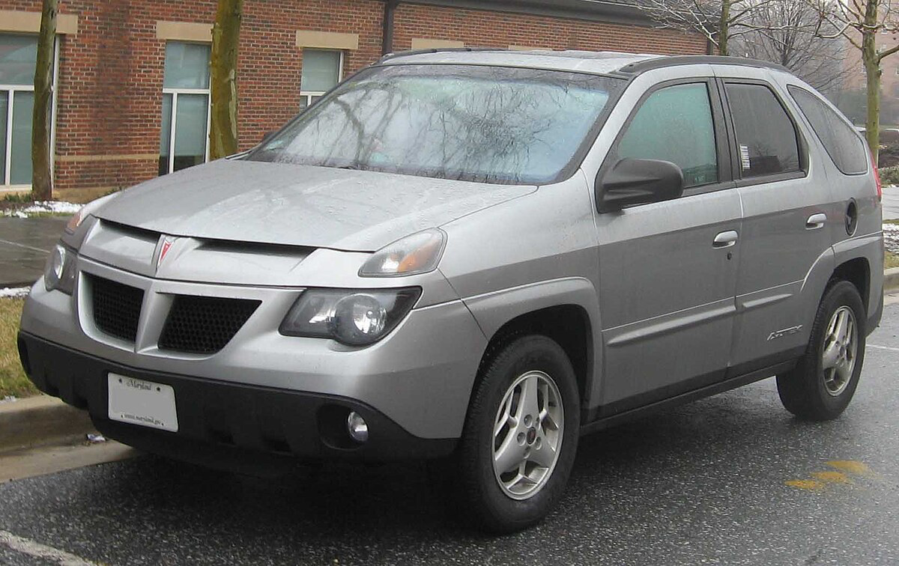
Notes:
Pontiac Aztek

Slide 23
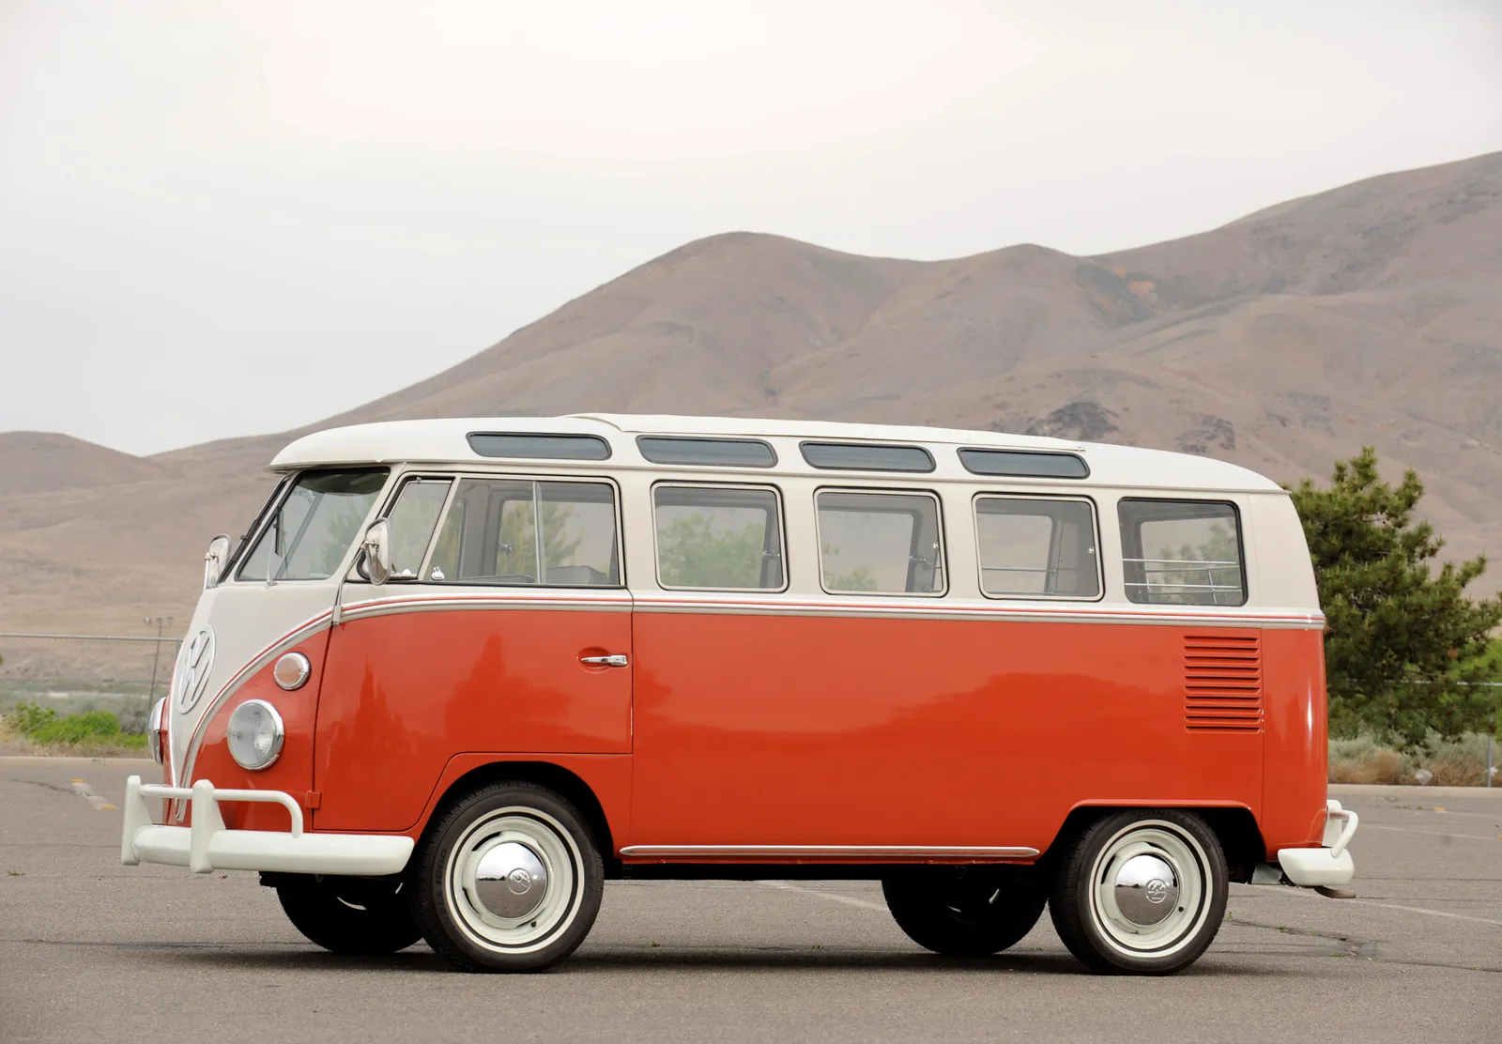
Notes:
Volkswagen bus

Slide 24
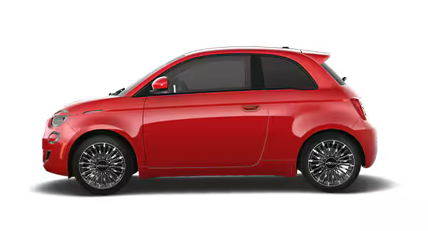
Notes:
Fiat

Slide 25
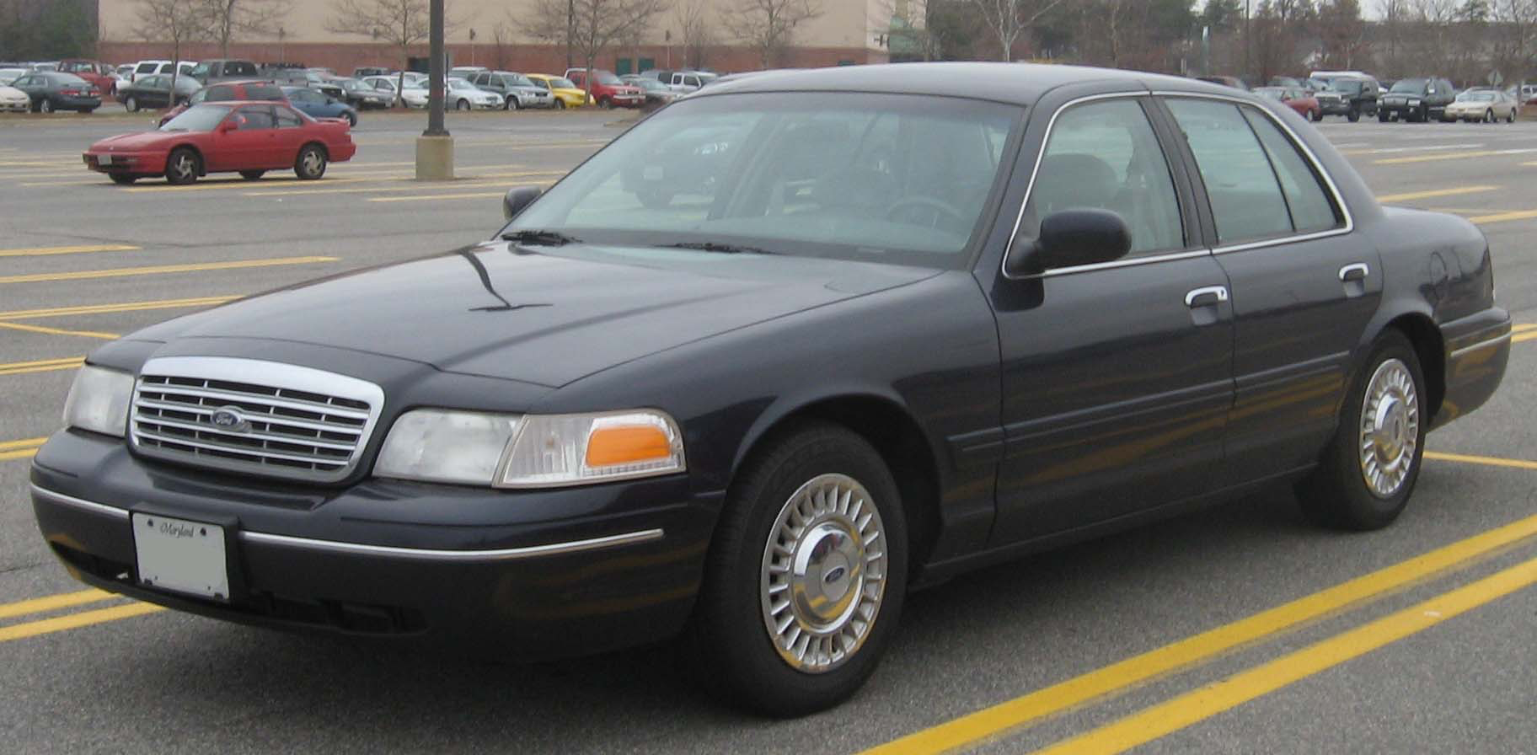
Notes:
Ford Crown Victoria

Slide 26

Notes:
Subaru

Slide 27
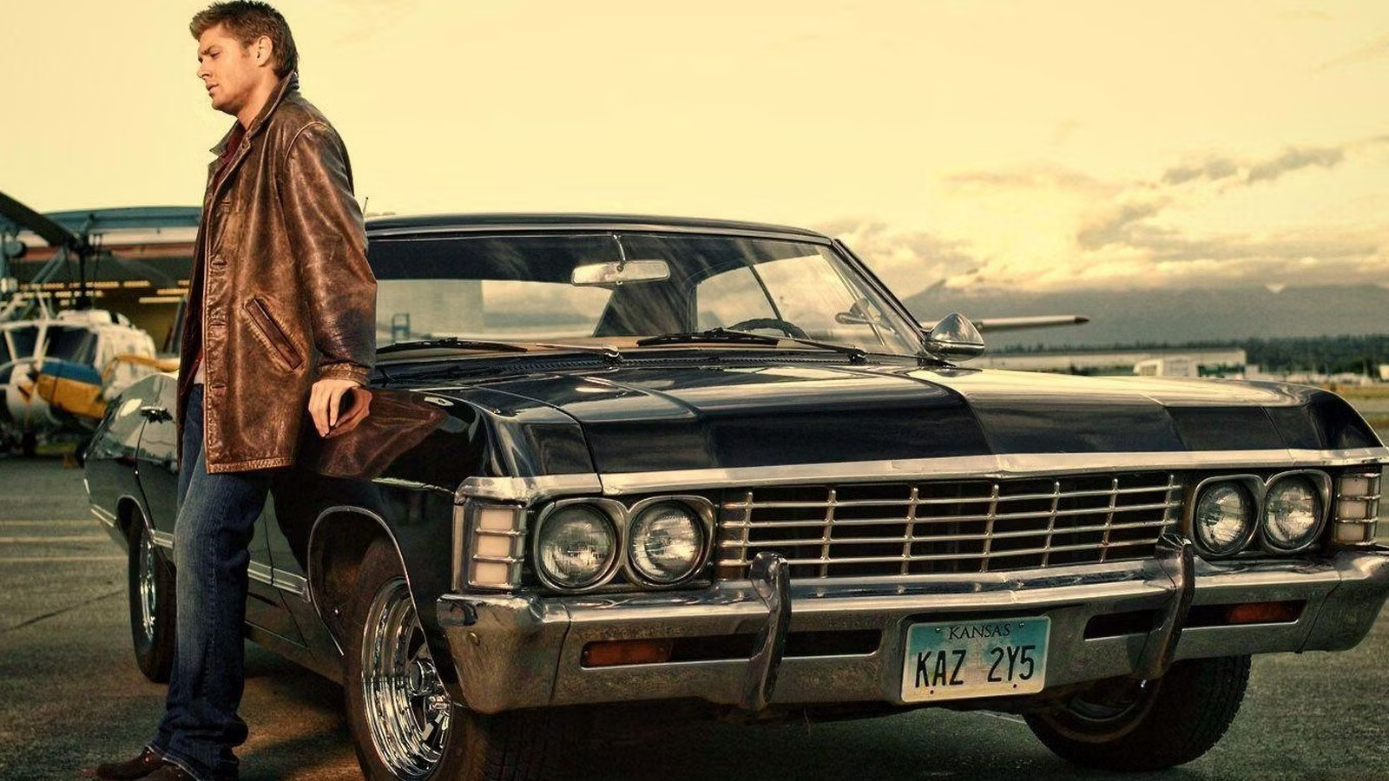
Notes:
1967 chevy impala

Slide 28
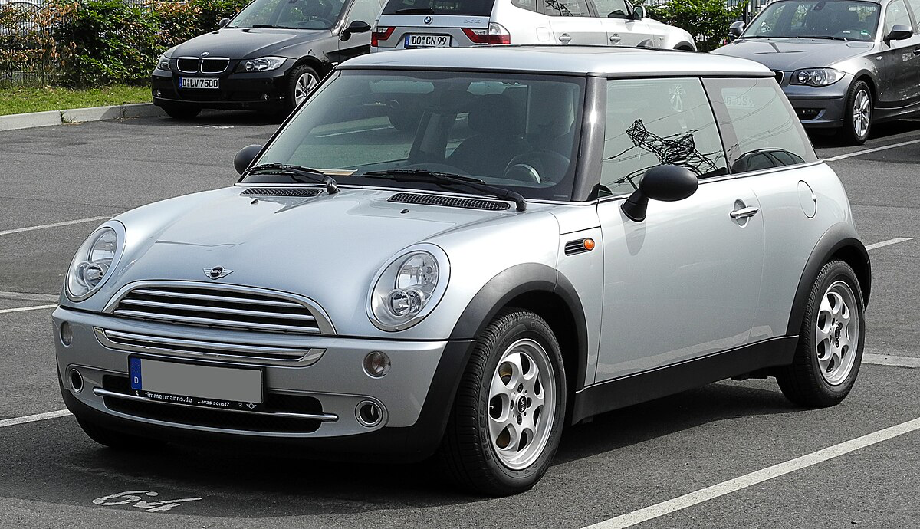
Notes:
Mini cooper

Slide 29

Notes:
Lightning McQueen

Slide 30
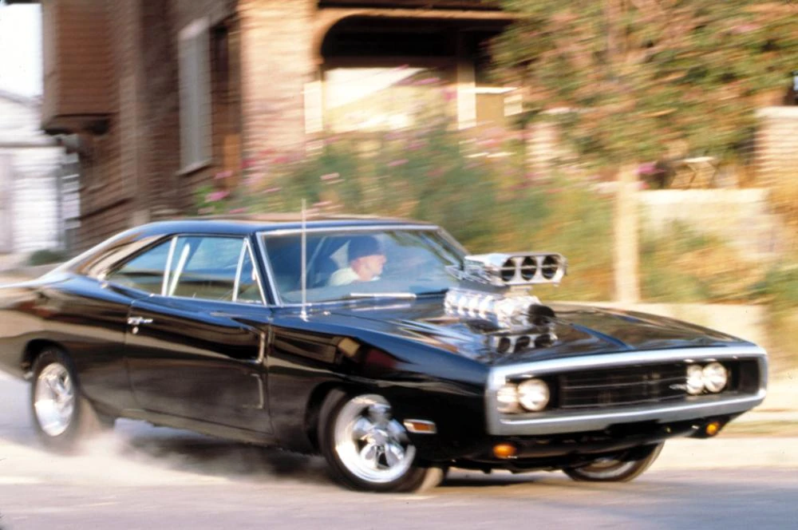
Notes:
1970 Dodge Charger

Slide 31
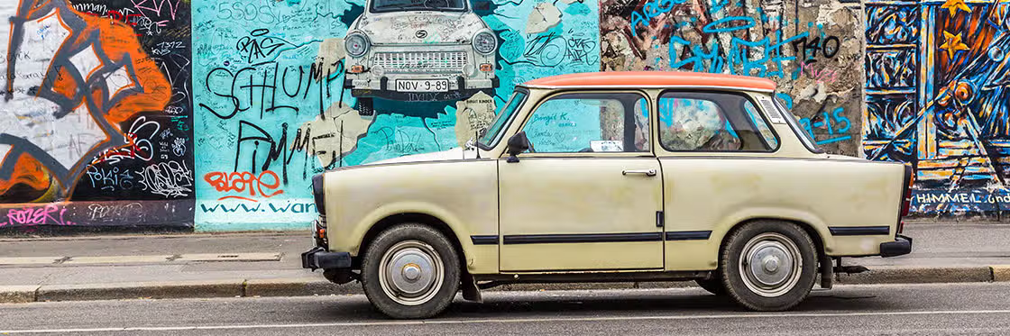
Notes:
Trabant

Slide 32
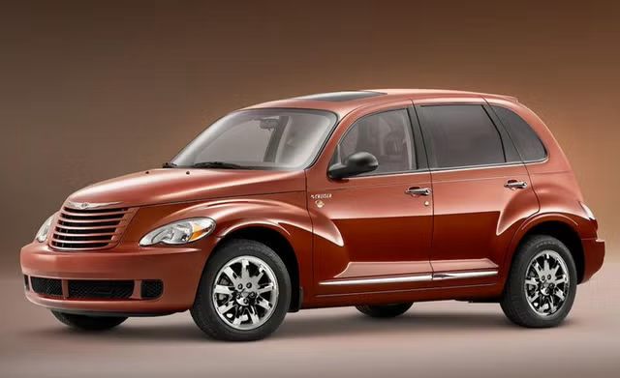
Notes:
PT Cruiser

Slide 33

Notes:
Tesla

Slide 34

Notes:
Audi

Slide 35
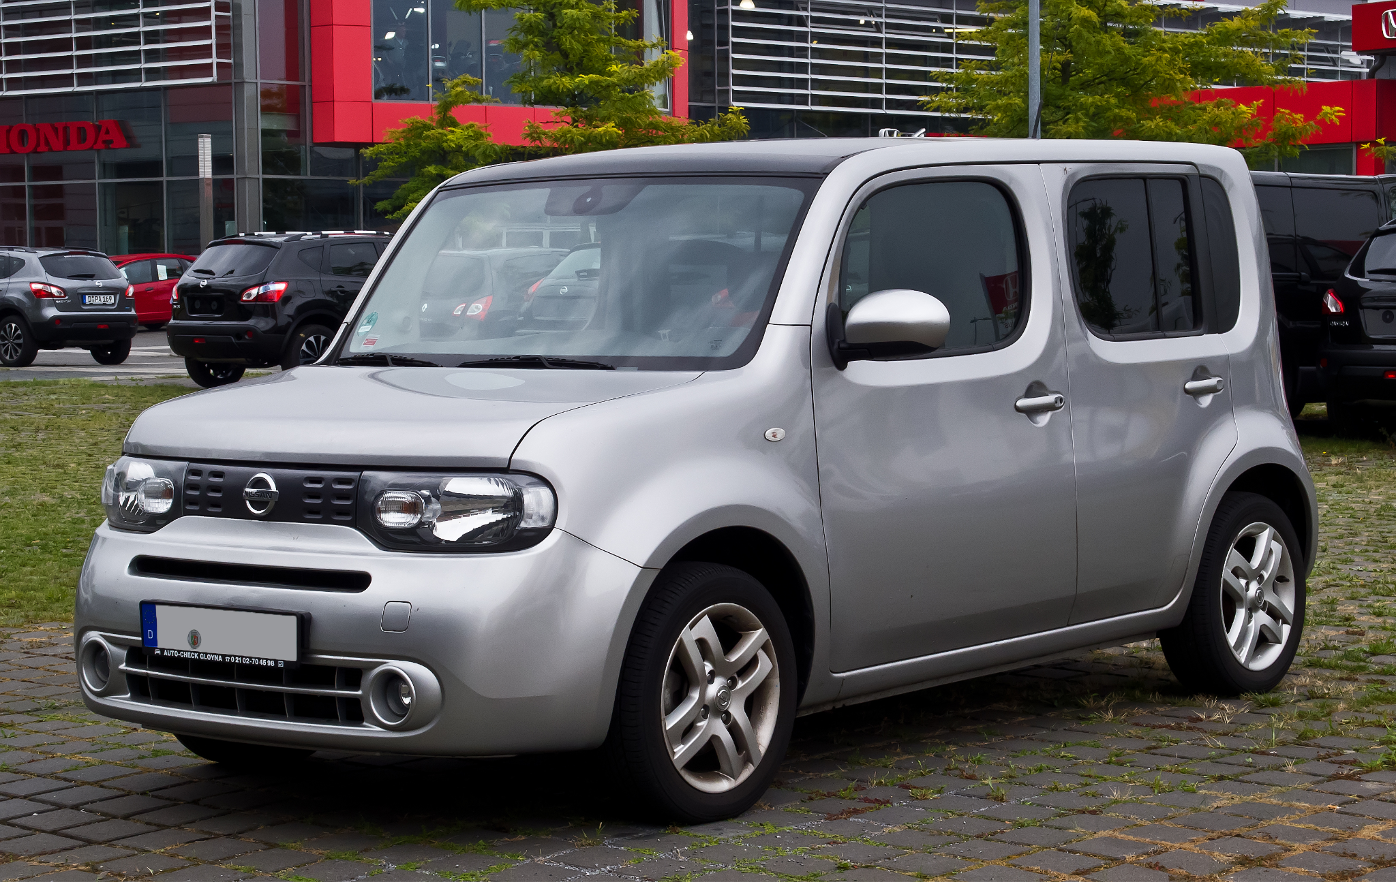
Notes:
Nissan cube

Slide 36

Notes:
Cadillac

Slide 37

Notes:
Jaguar

Slide 38
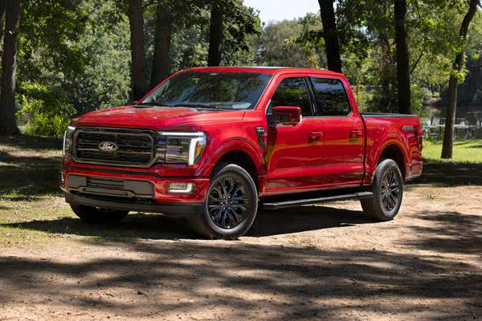
Notes:
Ford F150

Slide 39
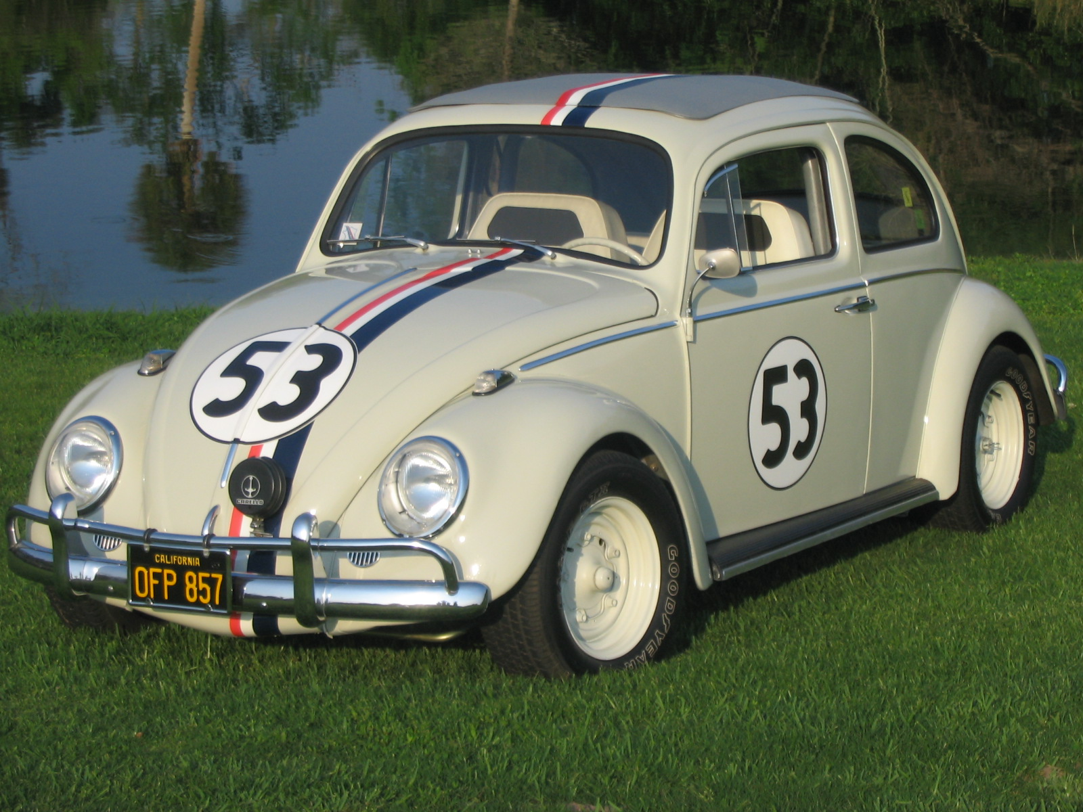
Notes:
Herbie

Slide 40
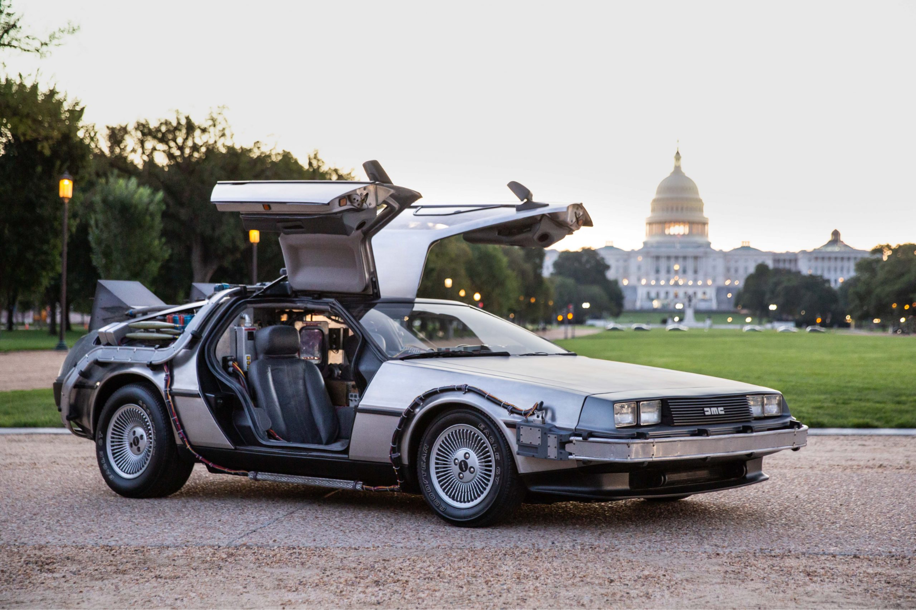
Notes:
Delorean

Slide 41
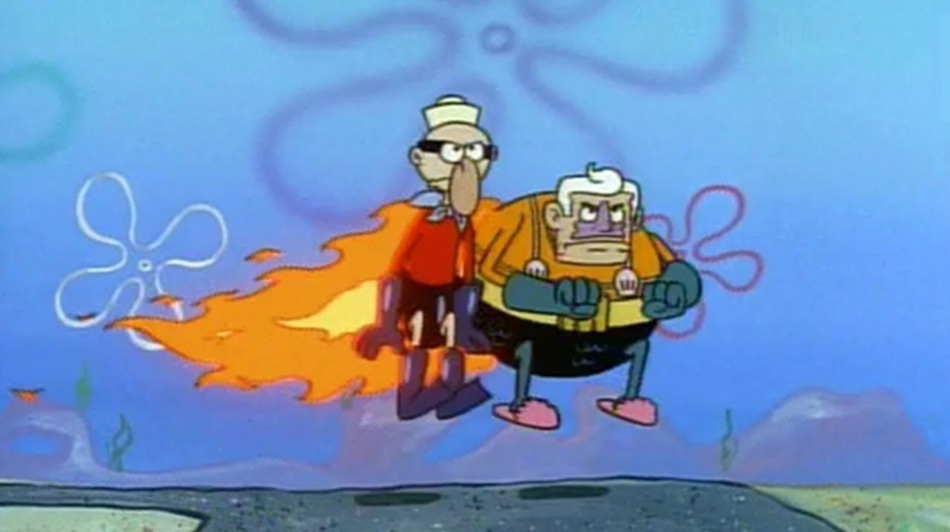
Notes:
Invisible Boatmobile

Slide 42
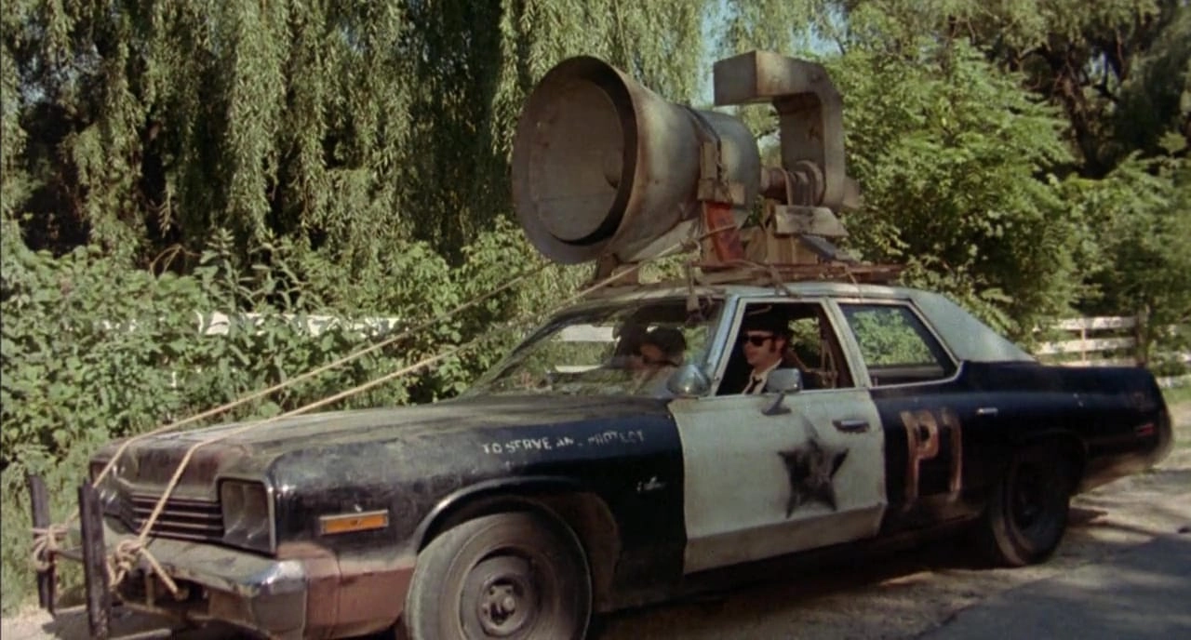
Notes:
The Bluesmobile

Slide 43
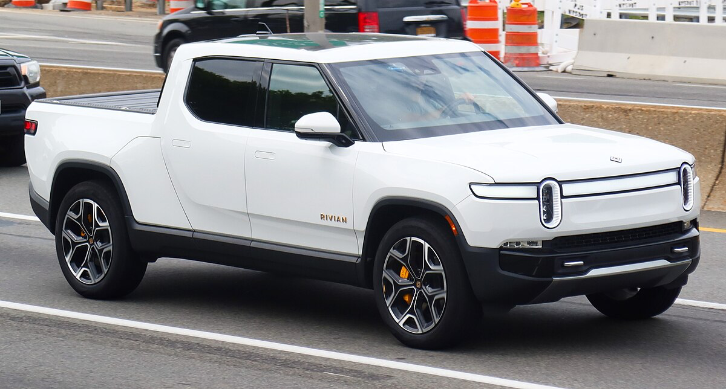
Notes:
Rivian R1T

Slide 44

Notes:
Corvette

Slide 45
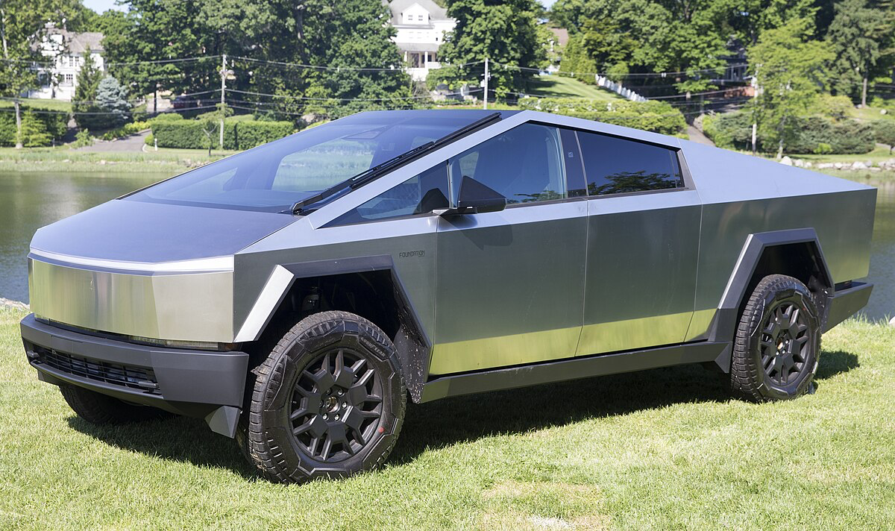
Notes:
cybertruck

Slide 46

Notes:
Volkswagen

Slide 47
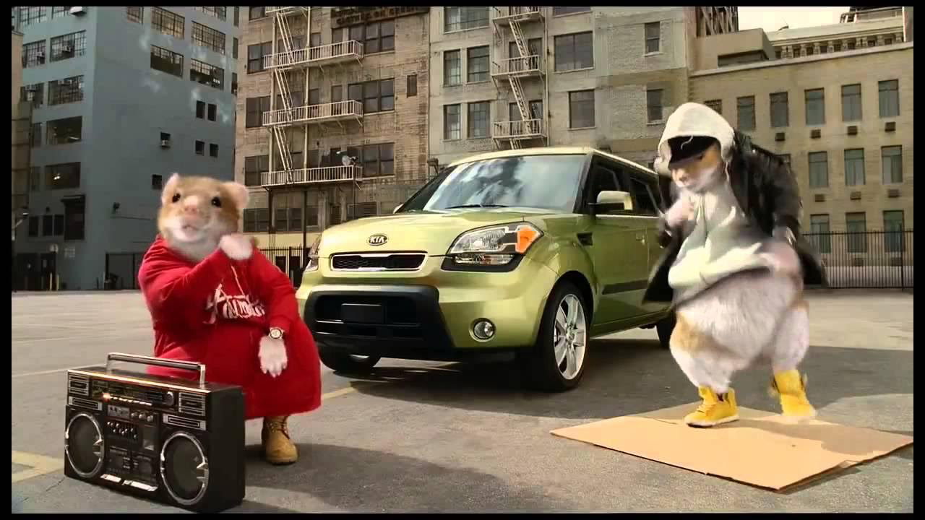
Notes:
Kia Soul

Slide 48
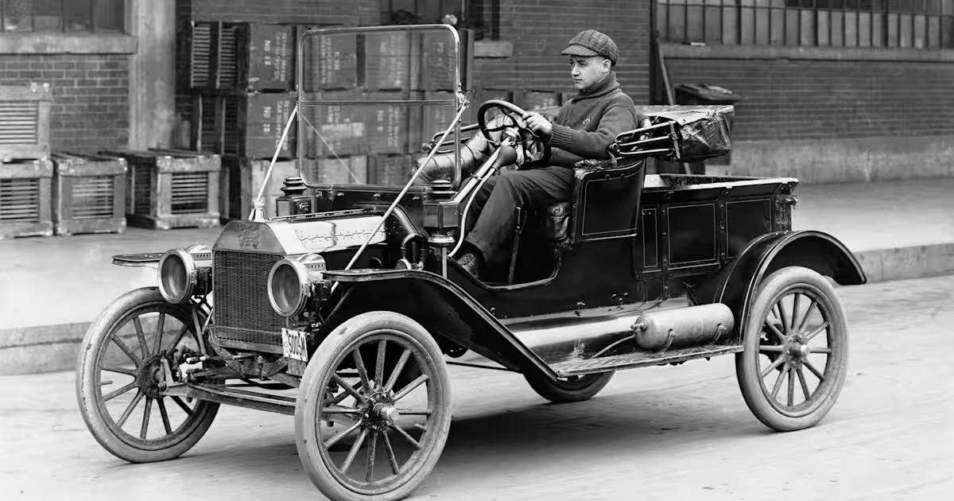
Notes:
Ford Model T

Slide 49
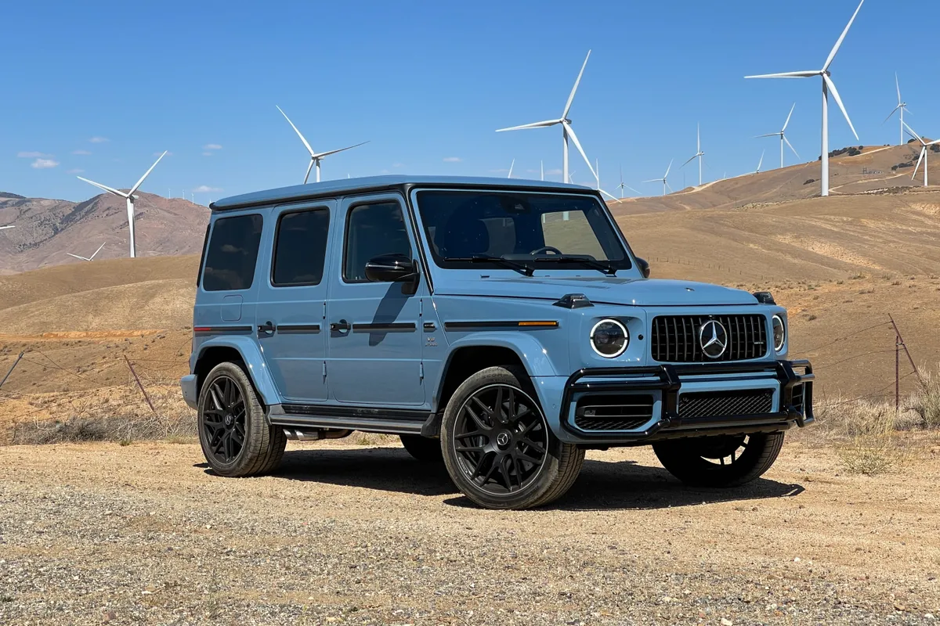
Notes:
Mercedes G Wagon

Slide 50

Notes:
Toyota

